Slide 1
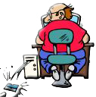
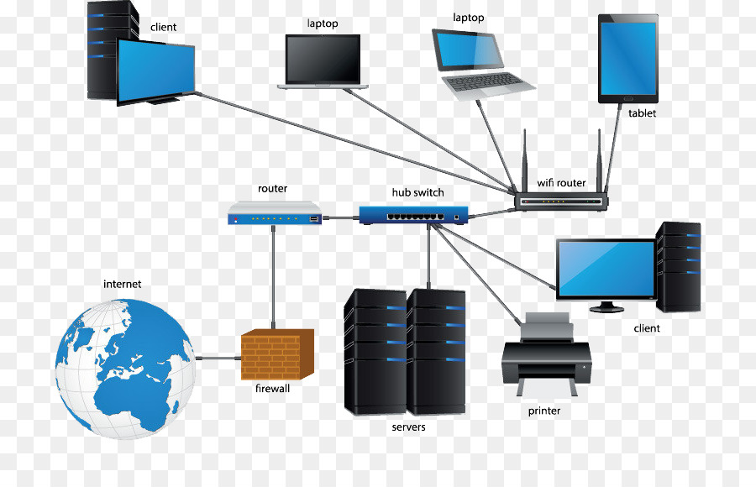
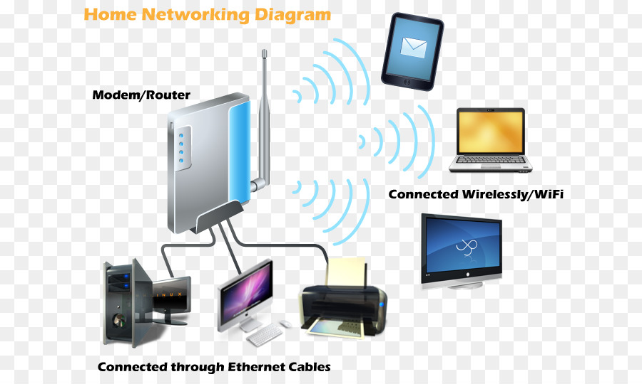
YEAR 7 DIGITAL TECHNOLOGIES
Glossary – Definitions that you need to know

Slide 2
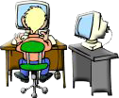
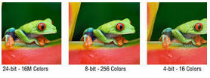
WeekS 1AND 2
Hex#123 00100010. Data, email: @
“Hello, Having a great time at Ursula Frayne Catholic College….”
Best of Jack Harlow.mp3, AC/DC.mp3
My car.jpg
This is the binary alphabet. Instead of writing the letter “A”, computers would write 01000001.
Binary numbers are always eight digits long and are only made up of zeros or ones.
Representation of Data:
Digital systems represent text, image and audio data
Images use pixels calculated by binary code known as bits per pixel (bpp), particularly when specified along with the number of bits used. Jpeg, Giff

Slide 3
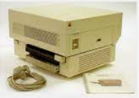
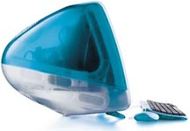
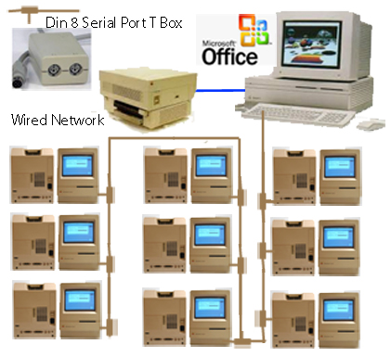
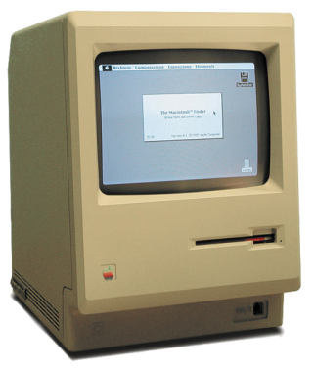
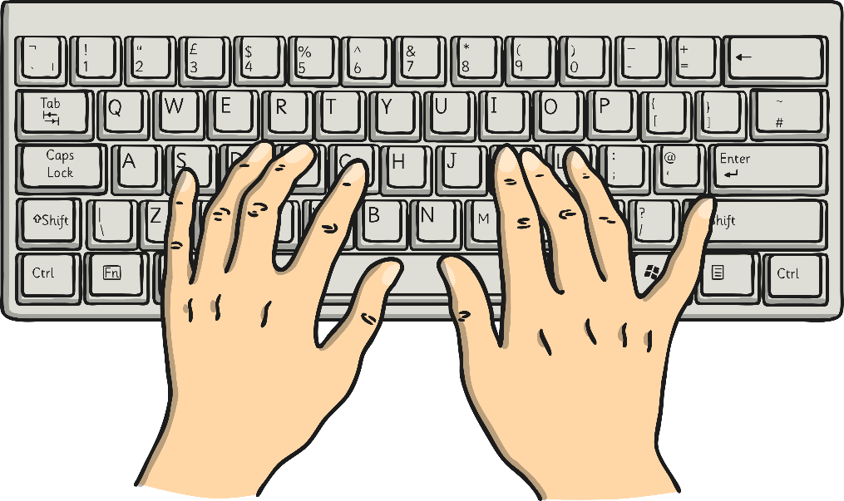
Digital System/s
Digital hardware and software components (internal and external) used to transform data into digital solutions.
When digital systems are connected they form a
network.

Slide 4
Data
This is the binary alphabet. Instead of writing the letter “A”, computers would write 01000001.
Binary numbers are always eight digits long and are only made up of zeros or ones.
In Digital Technologies, data refers to the discrete representation of information using number codes. Data may include characters (e.g. alphabetic letters, numbers and symbols), images, sounds and/or instructions that when represented by number codes can be manipulated, stored and communicated by digital systems. For example, characters may be represented using ASCII code or images may be represented by a bitmap of numbers representing each ‘dot’ or pixel.
ASCII, stands for American Standard Code for Information Interchange. It's a 7-bit character code where every single bit represents a unique character.
A | 01000001 | N | 01001110
B | 01000010 | O | 01001111
C | 01000011 | P | 01010000
D | 01000100 | Q | 01010001
E | 01000101 | R | 01010010
F | 01000110 | S | 01010011
G | 01000111 | T | 01010100
H | 01001000 | U | 01010101
I | 01001001 | V | 01010110
J | 01001010 | W | 01010111
K | 01001011 | X | 01011000
L | 01001100 | Y | 01011001
M | 01001101 | Z | 01011010

Slide 5
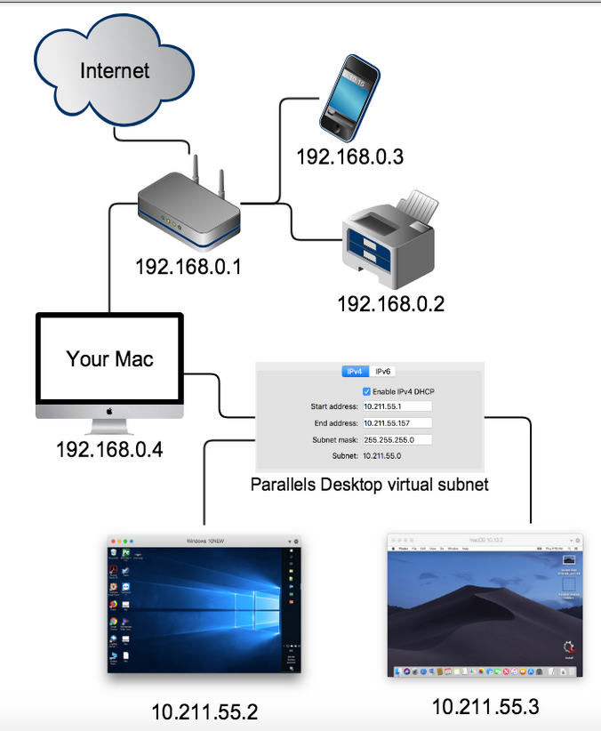
Week 3
Digital Systems: PAN, LAN, WAN, MAN…
Different types of networks, including wired, wireless and mobile networks

Slide 6
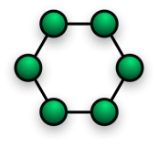
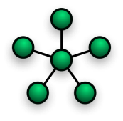
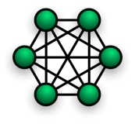
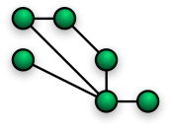
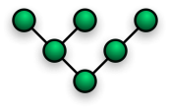
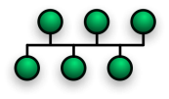
Network/s
A system of connecting computer systems or peripheral devices, each one remote from the others.

Slide 7
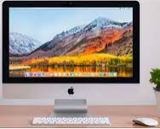
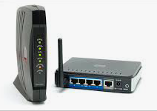
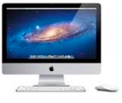
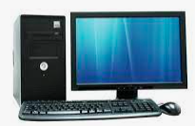
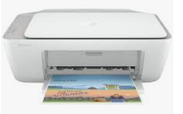
Wired Networks
Network hardware
Connected to a wire or system of wires, as an electronic device connecting computer systems or peripheral devices.
From ISP (NBN)
Router
Router
Modem
Computer 3
Computer 2
Printer from Modem
Main Server
Computer 1
Peter Faulks Year 7 Digital Technologies. Slide 7

Slide 8
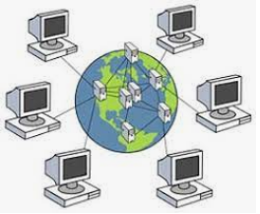
Wireless Networks
Any type of computer network that uses wireless data connections for connecting networks.
An Internet service provider (ISP) sells
wi-fi to your
home, what influences cost of this service, (Speed) wi-fi is connected by Nodes (NBN)
Peter Faulks Year 7 Digital Technologies. Slide 8

Slide 9
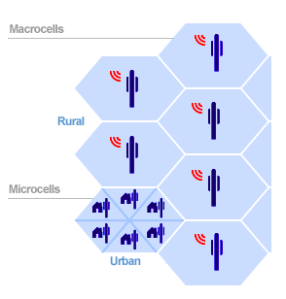
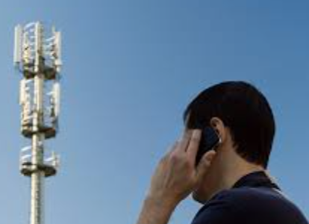
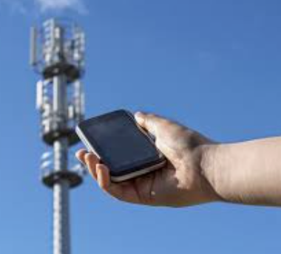
Mobile Networks
A system of connecting movable computer systems or peripheral devices, each one remote from the others.
Peter Faulks Year 7 Digital Technologies. Slide 9

Slide 10
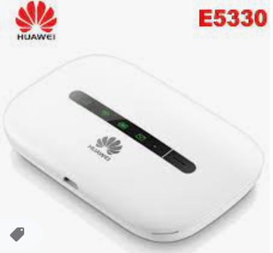
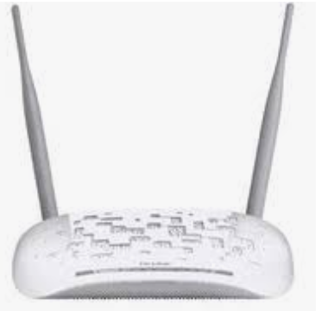
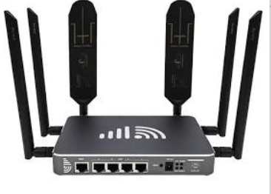
Digital Systems: Hardware components of a network
A modem is a small box that connects your devices to the Internet using cables. Unlike a router, a modem doesn't provide your home with Wi-Fi connectivity. A modem acts as a digital translator, taking an information signal from your cable, fiber or phone lines and making it accessible to your computer.
Modem
Router
Switch
Hub
Modem rear connectors using Ethernet cables
Portable Modem
Modem
Peter Faulks Year 7 Digital Technologies. Slide 10

Slide 11
Digital Systems: Hardware components of a network
Your modem is a box that connects your home network to the wider Internet. A router is a box that lets all of your wired and wireless devices use that Internet connection at once and also allows them to talk to one another without having to do so over the Internet.
A router is a box that lets all of your wired and wireless devices use that Internet connection at once and also allows them to talk to one another without having to do so over the Internet. Often, your Internet service provider will give you one box that serves as both modem and router, but they’re still different technologies; not all modems include routers and not all routers have modems.
Modem
Router
Switch
Hub
https://www.nytimes.com/wirecutter/blog/modem-vs-router/
Peter Faulks Year 7 Digital Technologies. Slide 11

Slide 12
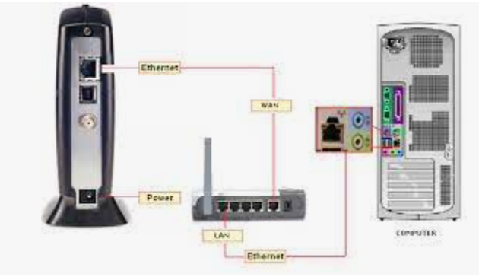
Digital Systems: Hardware components of a network
Your modem is a box that connects your home network
to the wider Internet. A router is a box that lets all of
your wired and wireless devices use that Internet
connection at once and also allows them to talk to one
another without having to do so over the Internet.
A router is a box that lets all of your wired and wireless devices use that Internet connection at once and also allows them to talk to one another without having to do so over the Internet. Often, your Internet service provider will give you one box that serves as both modem and router, but they’re still different technologies; not all modems include routers and not all routers have modems.
Modem
Router
Switch
Hub
https://www.nytimes.com/wirecutter/blog/modem-vs-router/
Peter Faulks Year 7 Digital Technologies. Slide 12

Slide 13
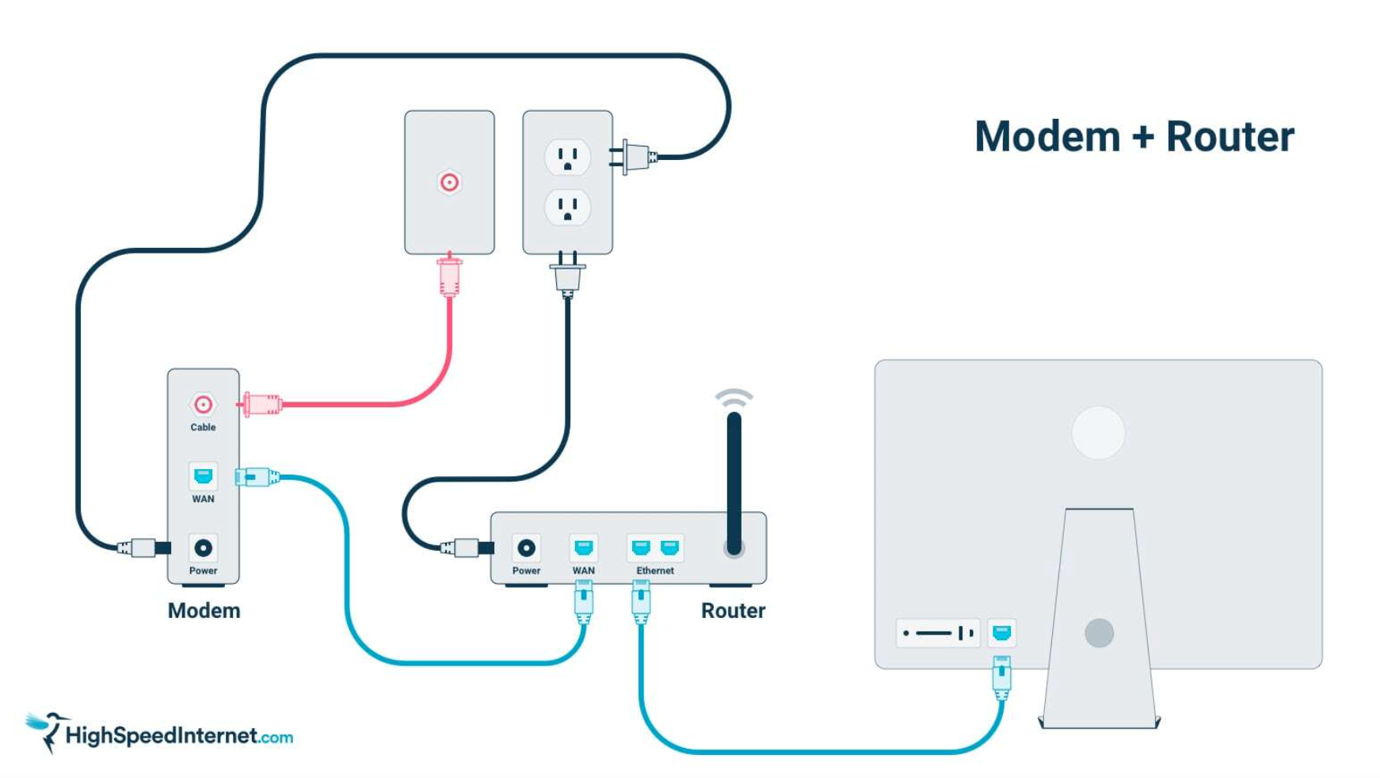
Digital Systems: Hardware components of a network
https://www.highspeedinternet.com/resources/what-cables-do-i-need-to-connect-my-router-to-my-computer
Phone
line in
Modem
and
Router
Switch
Hub
Can connect to Computer 2
Computer 1
Peter Faulks Year 7 Digital Technologies. Slide 13

Slide 14
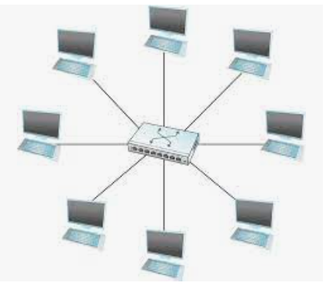
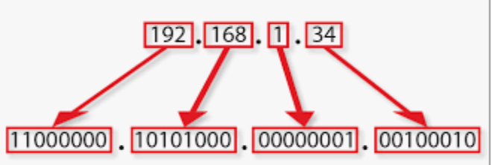
Digital Systems: Hardware components of a network
A switch is a device in a computer network that connects other devices together. Multiple data cables are plugged into a switch to enable communication between different networked devices.
Even though a switch has a fixed number of inputs and outputs, which limits the number of hosts that can be connected to a single switch, large networks can be built by interconnecting a number of switches.
Every host on a switched network has its own link to the switch, One thing that is common to all networks is that we need to have a way to identify the end nodes. Such identifiers are usually called addresses.
Modem
Router
Switch
Hub
10.1.1.1 This is a sample iP address, each computer has its own iP address 192.168.1.34
Peter Faulks Year 7 Digital Technologies. Slide 14

Slide 15
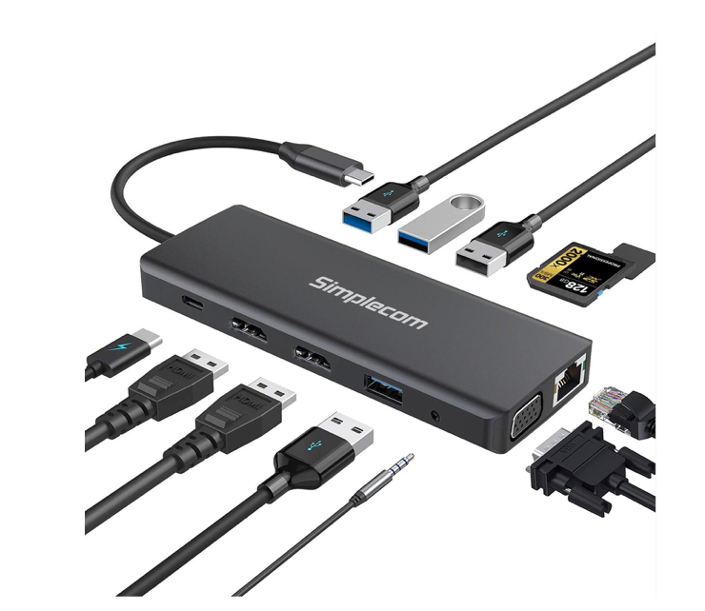
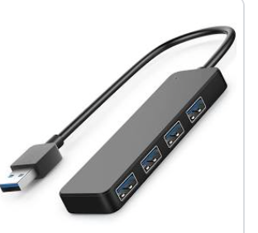
Digital Systems: Hardware components of a network
A USB hub is a device that allows you to connect multiple USB devices to your computer. It can be useful if you have more than one device that uses USB, such as a... mouse and keyboard or a printer and external hard drive. Browse the top-ranked list of USB hubs for PC below along with associated reviews and opinions.
Modem
Router
Switch
Hub
The better hubs are powered
Peter Faulks Year 7 Digital Technologies. Slide 15

Slide 16
Hardware
The collection of physical elements that comprise a computer system.
Peter Faulks Year 7 Digital Technologies. Slide 16

Slide 17
Components
The parts or elements that make up a system or whole object and perform specific functions.
For example, the major components of a car include: the chassis (holds everything on it); the engine (to convert energy to make the car move); the transmission (including controlling the speed and output from the engine and to rotate the wheels); the steering system (to control the direction of movement); brake system (to slow down or stop); fuel delivery system (to supply fuel to the cylinders); exhaust system (to get rid of gases) and the electrical system (for operating wipers, air conditioning, etc.).

Slide 18
Components (part 2)
Similarly, the components of a computer system may be a central processing unit (chips that follow instructions to control other components and move data); memory chips and a hard disk (for storing data and instructions); keyboard, mouse, camera and microphone (to input instructions and data for the central processing unit); screen, printer, and speakers (to output data); USB and ethernet cards (to communicate with other systems or components).

Slide 19
Network/S (from week 3)
A system of connecting computer systems or peripheral devices, each one remote from the others.
Peter Faulks Year 7 Digital Technologies. Slide 19

Slide 20
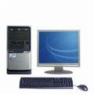
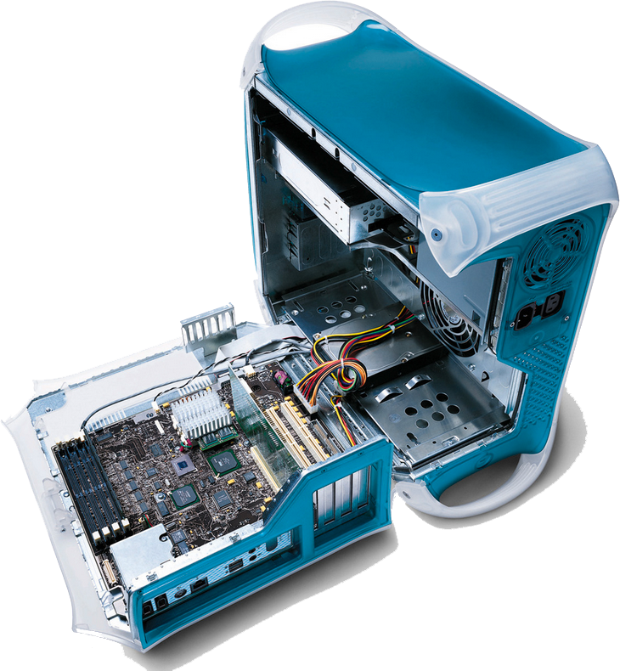
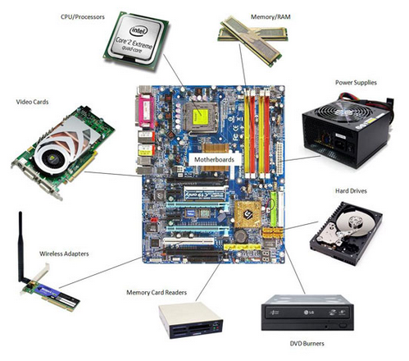
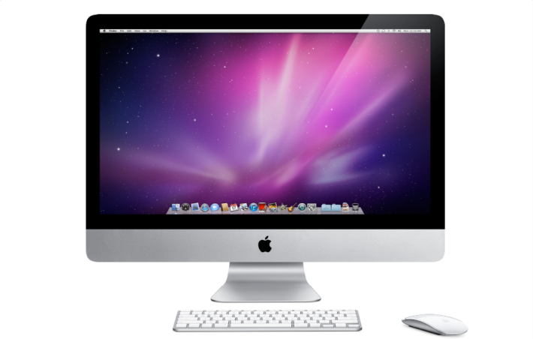
Week 5
About Computers
COMPUTER HARDWARE:
Peter Faulks Year 7 Digital Technologies. Slide 20

Slide 21
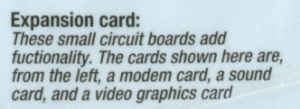
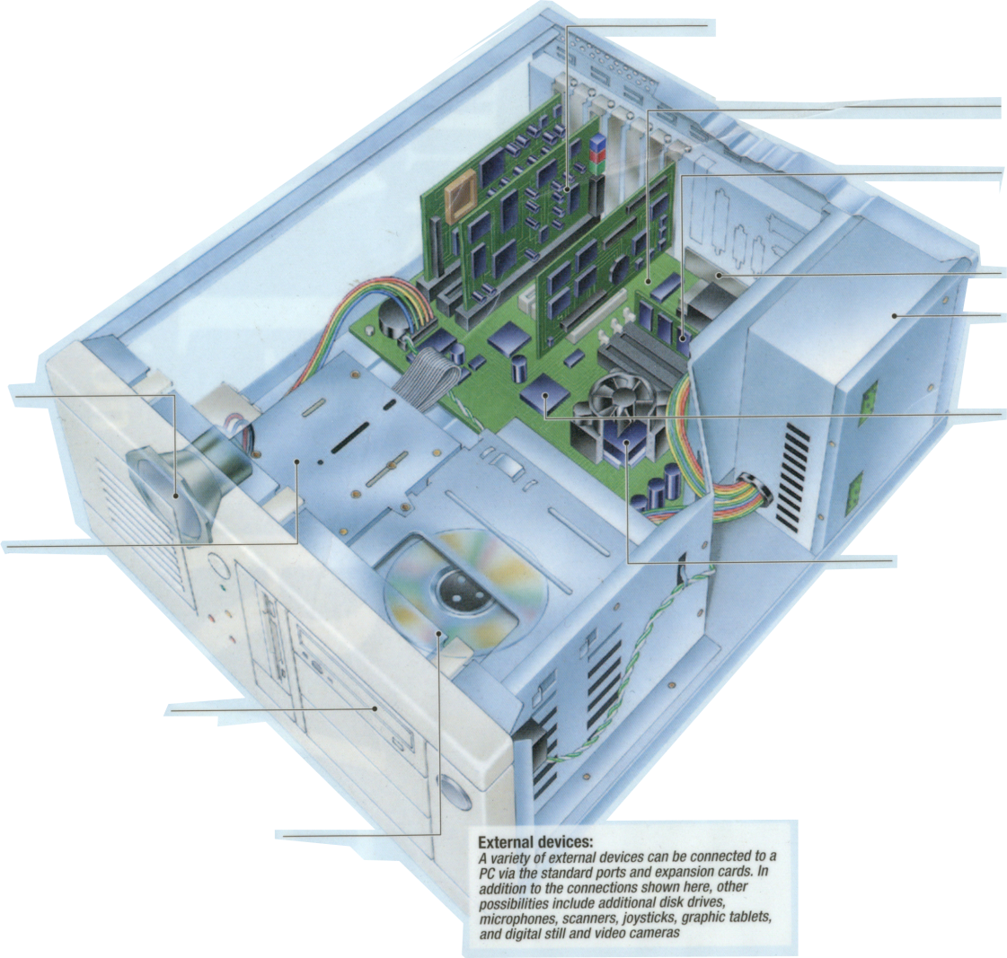
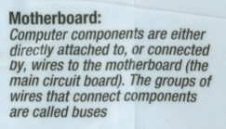
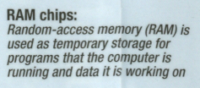
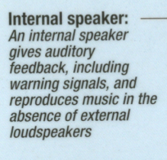
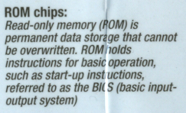
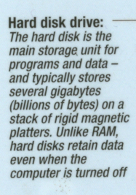
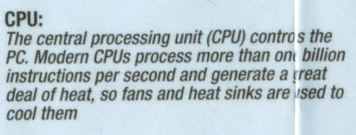
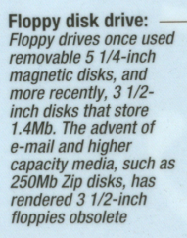
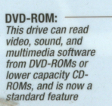
Inside a Computer Hardware (From Week 4)
The collection of physical elements that comprise a computer system.
Peter Faulks Year 7 Digital Technologies. Slide 21

Slide 22
Week 9
Digital Implementation:
Create and communicate information collaboratively online,
taking into account social contexts
Design a new “Gizmo” Digital Item, new or modified using planning by drawing a sketch (on A4 paper) of your NEW design with labels and explanations of what you are designing.
Complete the hardware task sheet and add your design
Use BRAINSTORMING to help plan a new piece of digital equipment this could be a ne lap top, and improved Keyboard, a new type of computer, or anything that you can think of that might be of use in the Digital Technology world
Peter Faulks Year 7 Digital Technologies. Slide 22

Slide 23
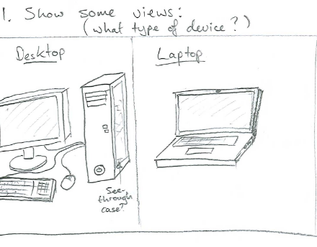
Create
Make and/or invent something
Your task will to create a new digital device or improve one that exists
Peter Faulks Year 7 Digital Technologies. Slide 23

